Slide 1
Understanding CSS
Introduction to styling.

Slide 2
Understanding CSS
Introduction to styling.

Slide 3
Understanding CSS
Introduction to styling.

Slide 4
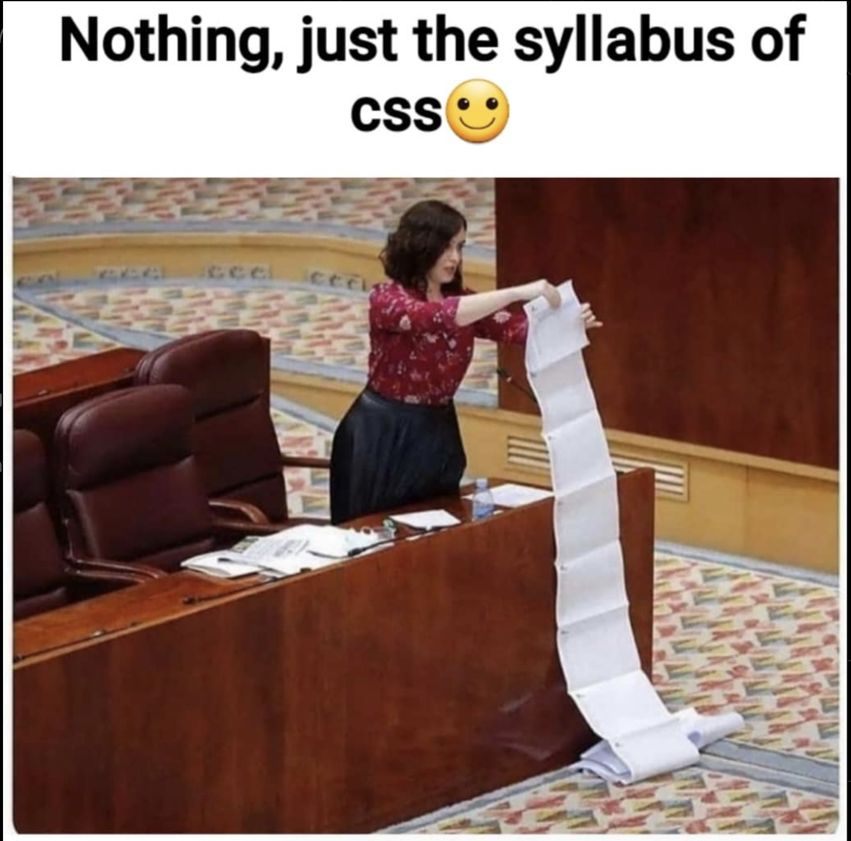

Slide 5


Slide 6
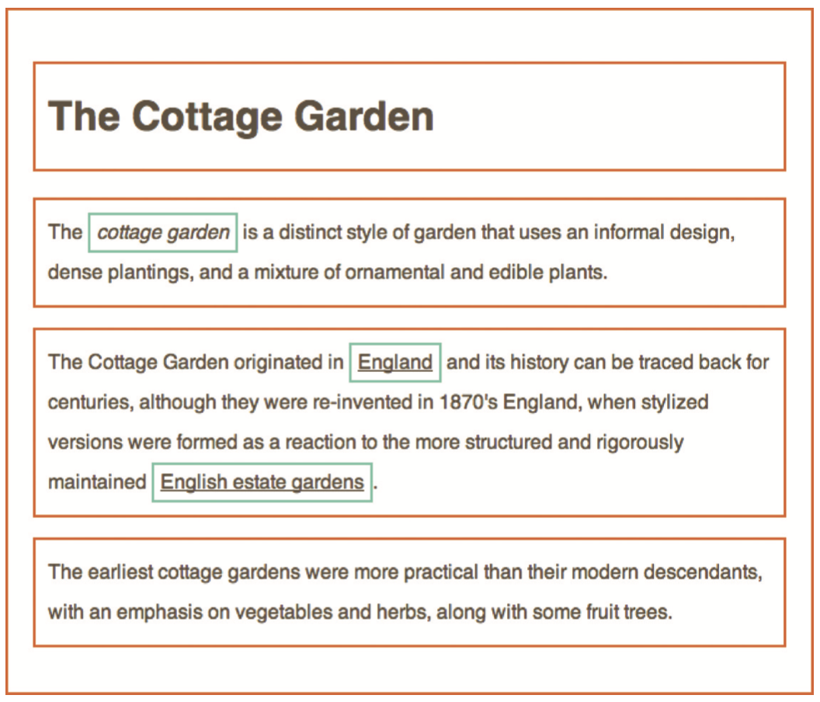

Slide 7
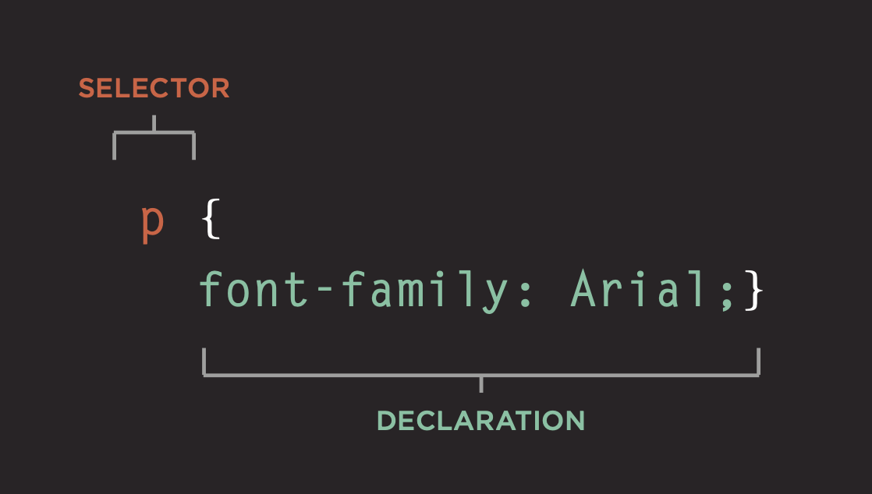

Slide 8
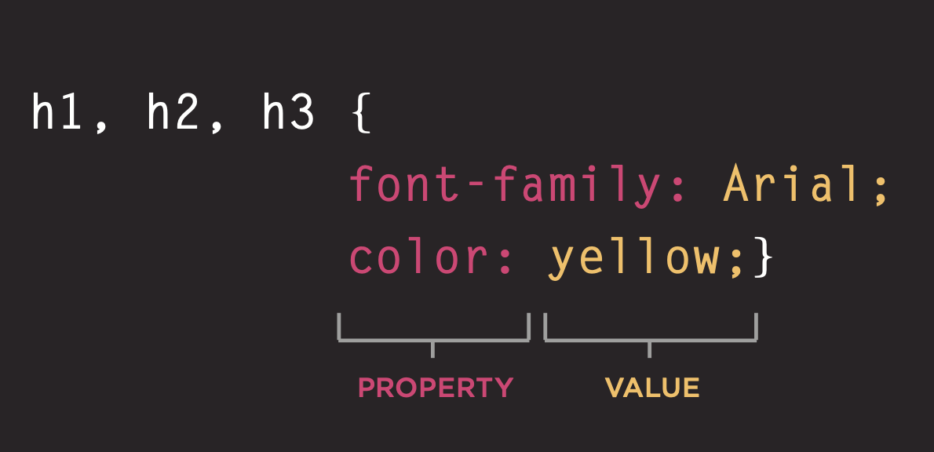

Slide 9
Types of CSS
Inline CSS
Styling within the tag
Internal CSS
Styling within the HTML file
External CSS
Styling in another css file and linking to HTML file.

Slide 10
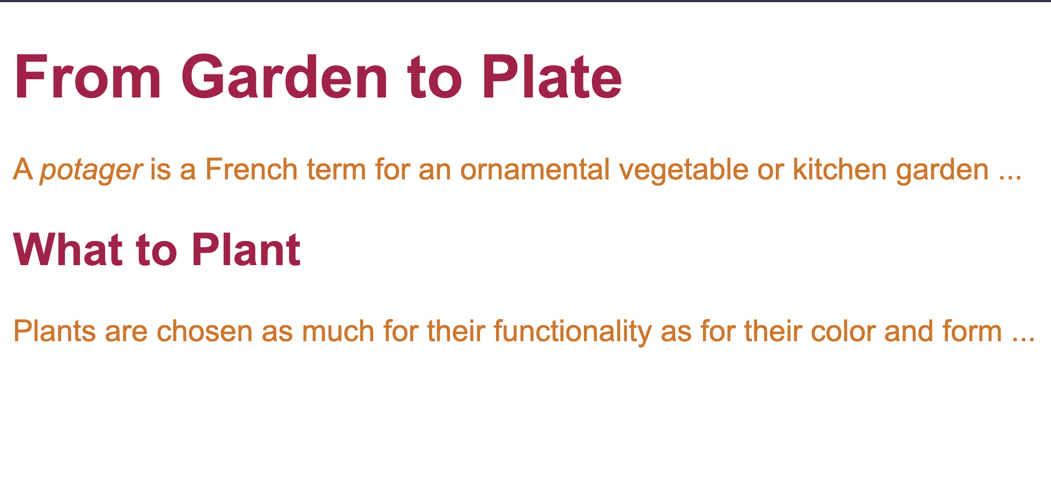
Example On VS Code.

